Slide 1

AtliQ Mart Sales Analysis
By: Jyothirmayi Lakkoju Code Basics Resume Challenge

Slide 2
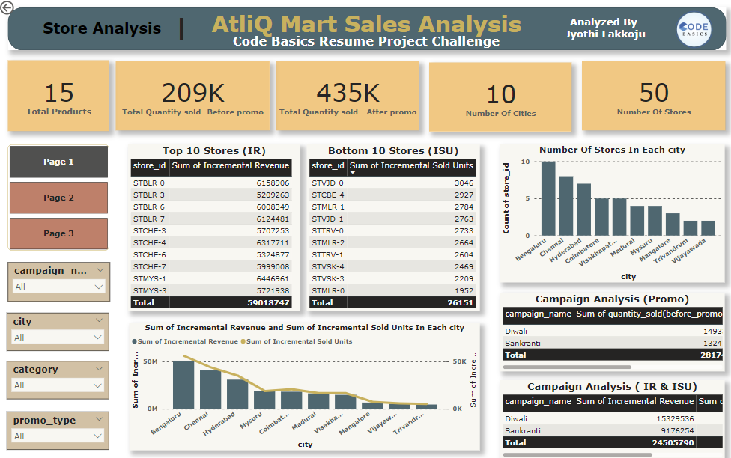
Conclusions Drawn From Store Analysis:
Distribution Of stores are unequal. Bengaluru, Chennai, Hyderabad have the most stores out of 50 with Bengaluru being the highest
More number of stores indicate more promotions , more revenue thereby more outcome
Regarding the campaign analysis Diwali has done well in terms of Incremental revenue but Sankranthi sold more units, hence it was well promoted in terms of quantity sold after promotions
Most of the Top 10 stores listed are from cities like Bengaluru , Chennai and Hyderabad.

Slide 3
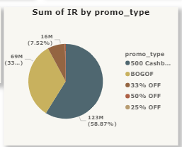
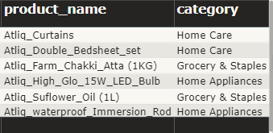
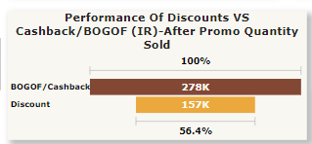
Among the 5 types of promos 500 cashback and BOGOF were the most successful ones .
50% and 25% are very much negligible
cashbacks and BOGO offers leverage consumer psychology and economic incentives to drive sales, foster customer loyalty, and increase the perceived value of the promotion compared to simple discounts.
Most of the products which got sold under BOGOF promo with a base price > 500 come under the category of Home care and appliances and grocery & staples
So continuing to promote more of the products or add new items to these categories will be beneficial
The performance of BOGOF/Cashbacks are almost twice the Discount.
Implementing these two promos extensively will most likely increase the sales and promote the product in the good light as well.

Slide 4
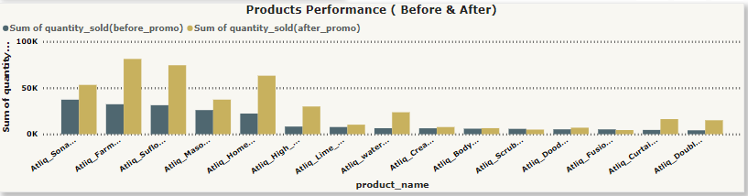
As observed from the above bar graph there are 2 products which failed slighty even after promotion
Those two products are “AtliQ Scrub sponge for dishwash” & “AtliQ fusion container set of 3”
The quantity sold after promotions is lower than before for these two particular products.
The decrease in quantity sold after promotions may be attributed to factors such as ineffective promotion execution, pricing perception issues, product quality concerns, or changing consumer preferences.
To address the decrease in quantity sold after promotions for the two specific products, consider reassessing the effectiveness of the promotional strategies and adjusting pricing or messaging accordingly. Gathering customer feedback can also provide valuable insights to refine future promotions and enhance product appeal.

Slide 5
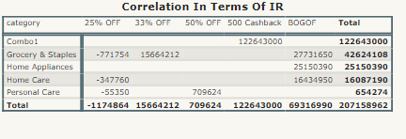
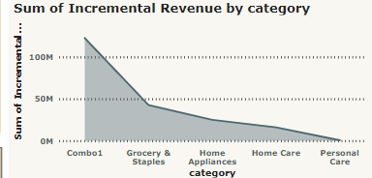
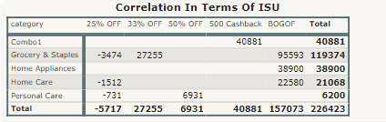

Slide 6
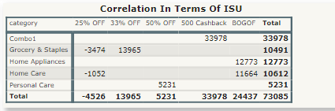
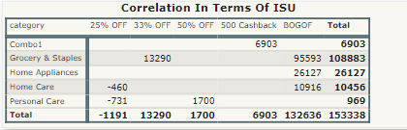
Campaign Diwali:
Diwali sold most units in the category “COMBO 1” and least in personal care
It did moderately well in terms of home care and appliances and grocery.
In terms of promotions the 25% off seems to be resulting in major loss , it would be better to completely eliminate it.
Campaign Sankranti:
Sankranti sold most units in Grocery and the least in personal care
During Sankranti, emphasis may shift towards purchasing items like food, sweets, and clothing rather than non-essential items like home care and personal care products. Understanding and adapting to these cultural preferences can help mitigate losses

Slide 7
THANK YOU

